Slide 2
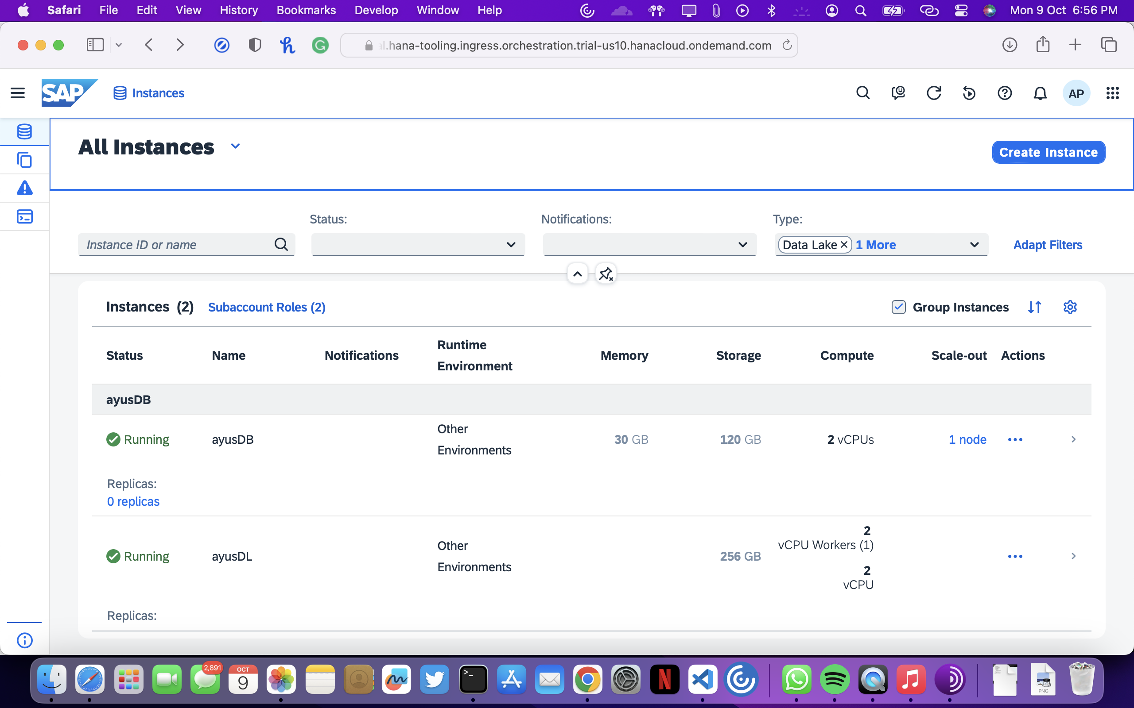

Slide 3
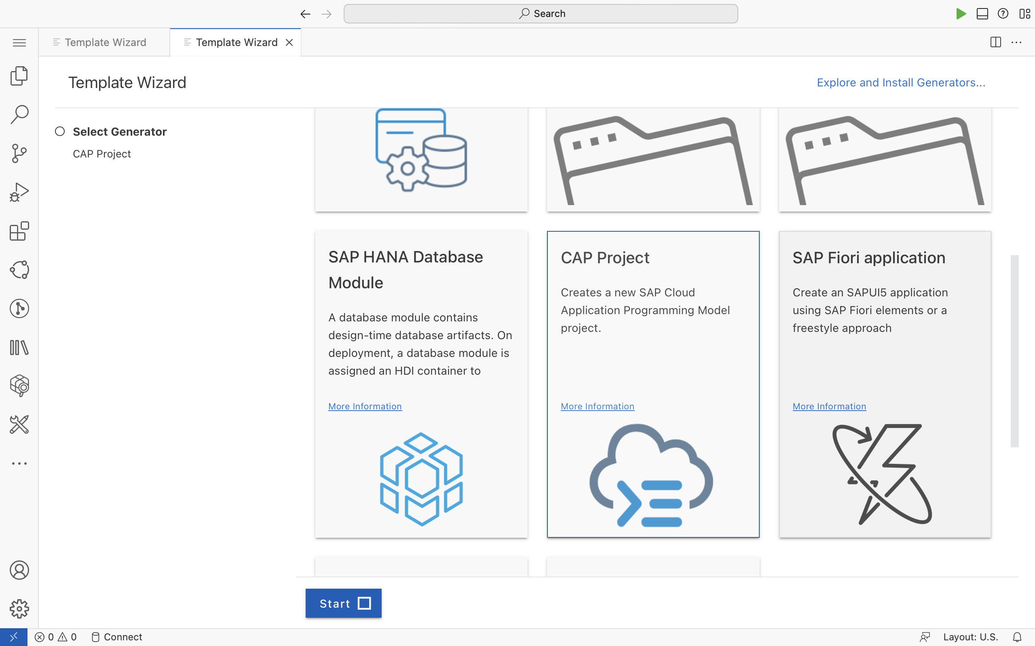

Slide 4
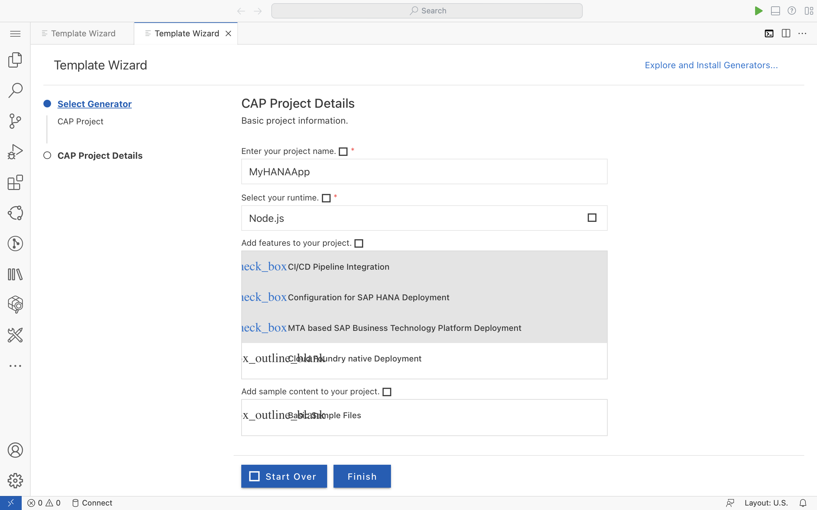

Slide 5
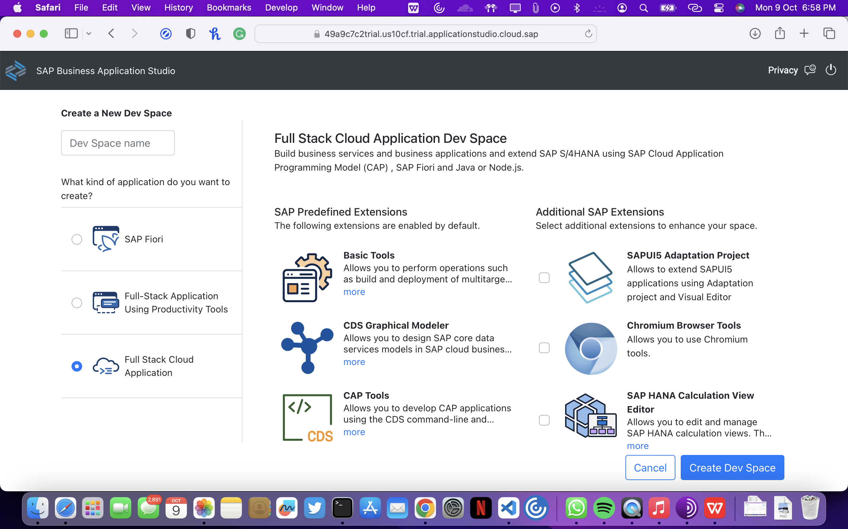

Slide 6
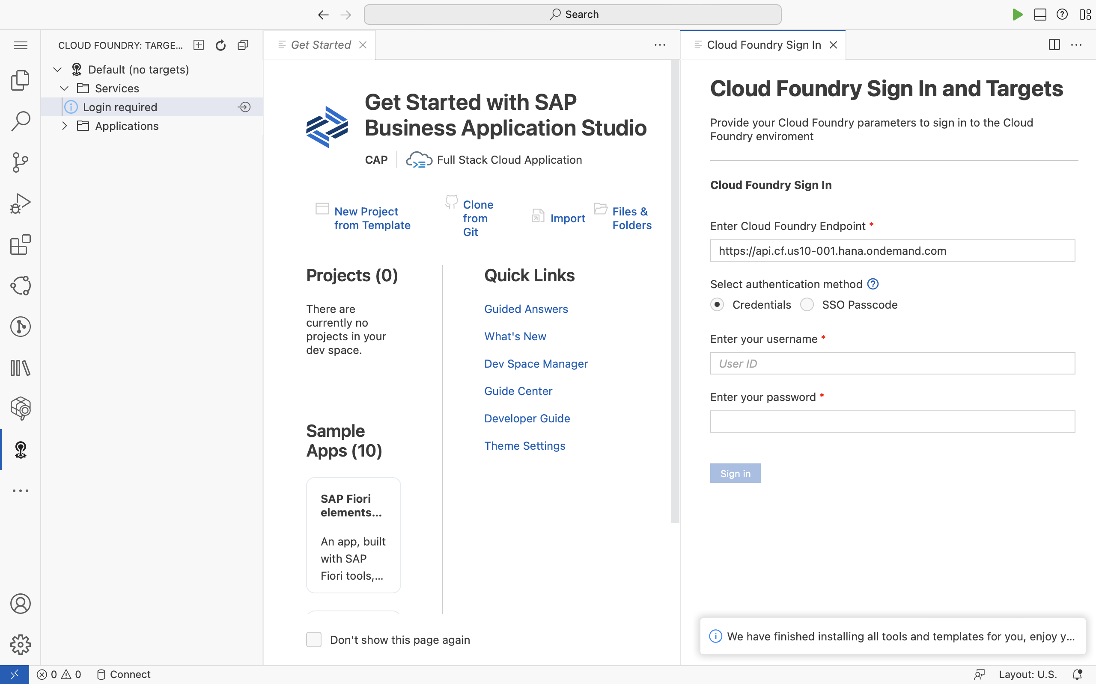

Slide 7
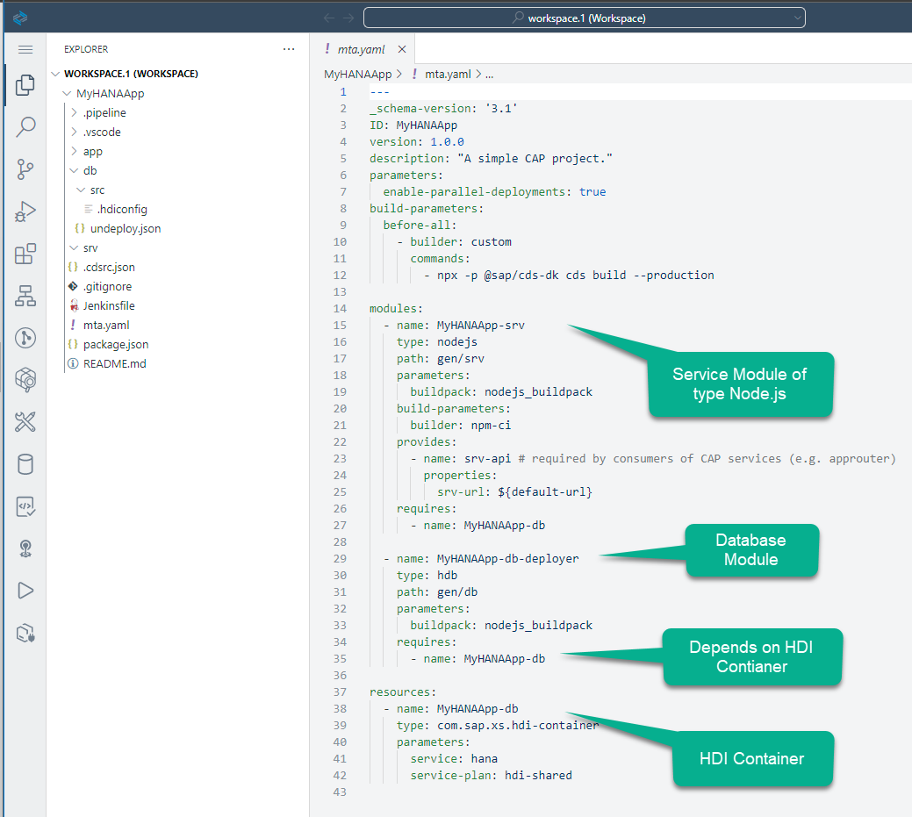
This file is the deployment descriptor and it is the glue that keeps all the micro-services together as a single application throughout its lifecycle. It declares the modules (applications or micro-services) and their dependencies with other micro-services or backing services.

Slide 8
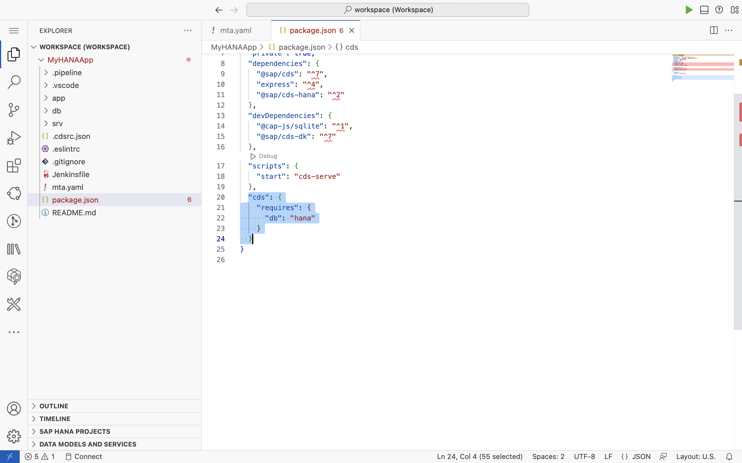
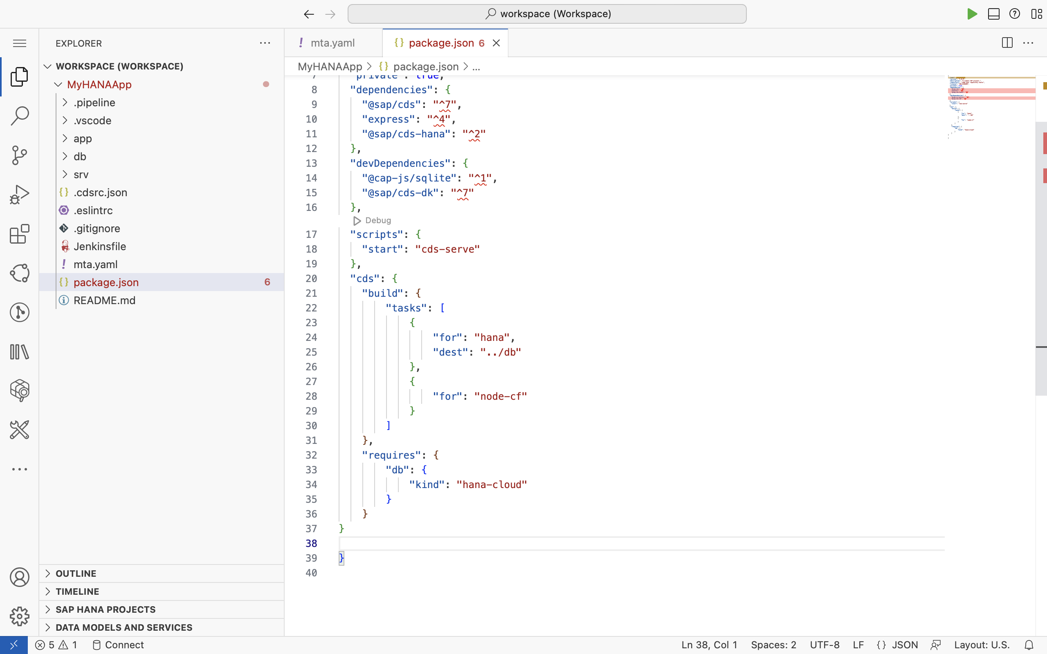
These changes will alter the generated folder structure of the cds build operation. Content will no longer be placed into the gen folder for the db module but back into the source folders. This also will tell CAP to generate hdbtable artifacts instead of hdbcds. This is a critical change for SAP HANA Cloud compatibility. Finally the db.kind change to HANA tells CAP to use HANA Cloud at development time instead of SQLite.

Slide 9
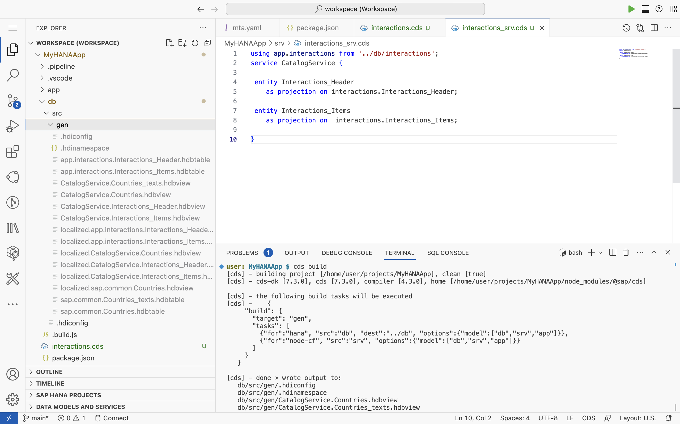

Slide 11
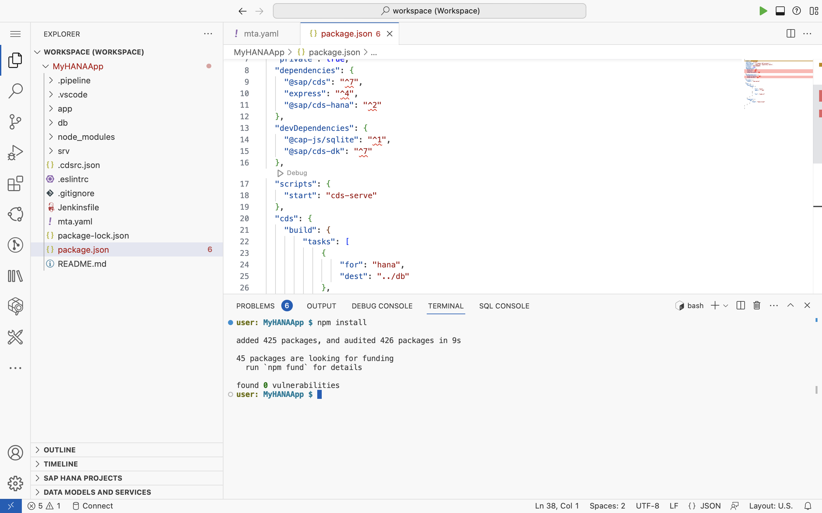

Slide 12
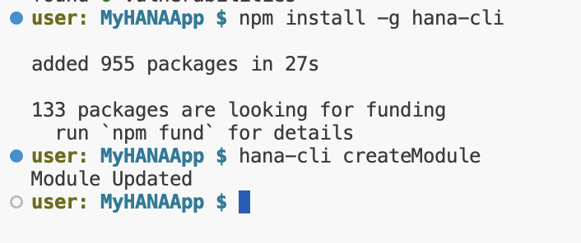

Slide 14
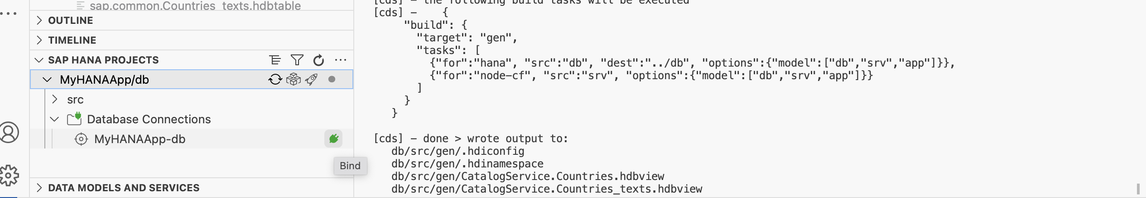

Slide 15
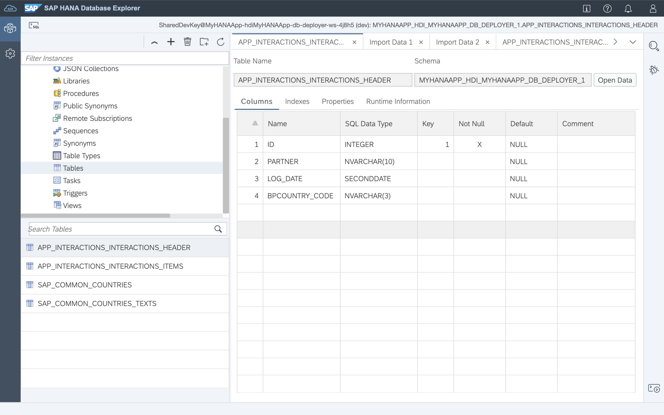
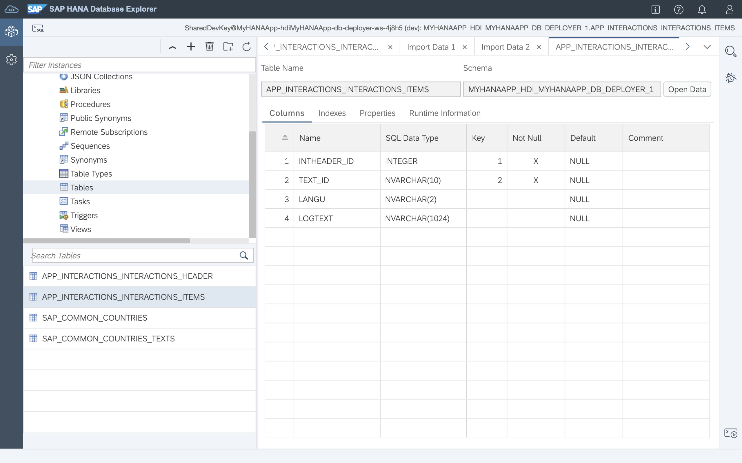

Slide 16
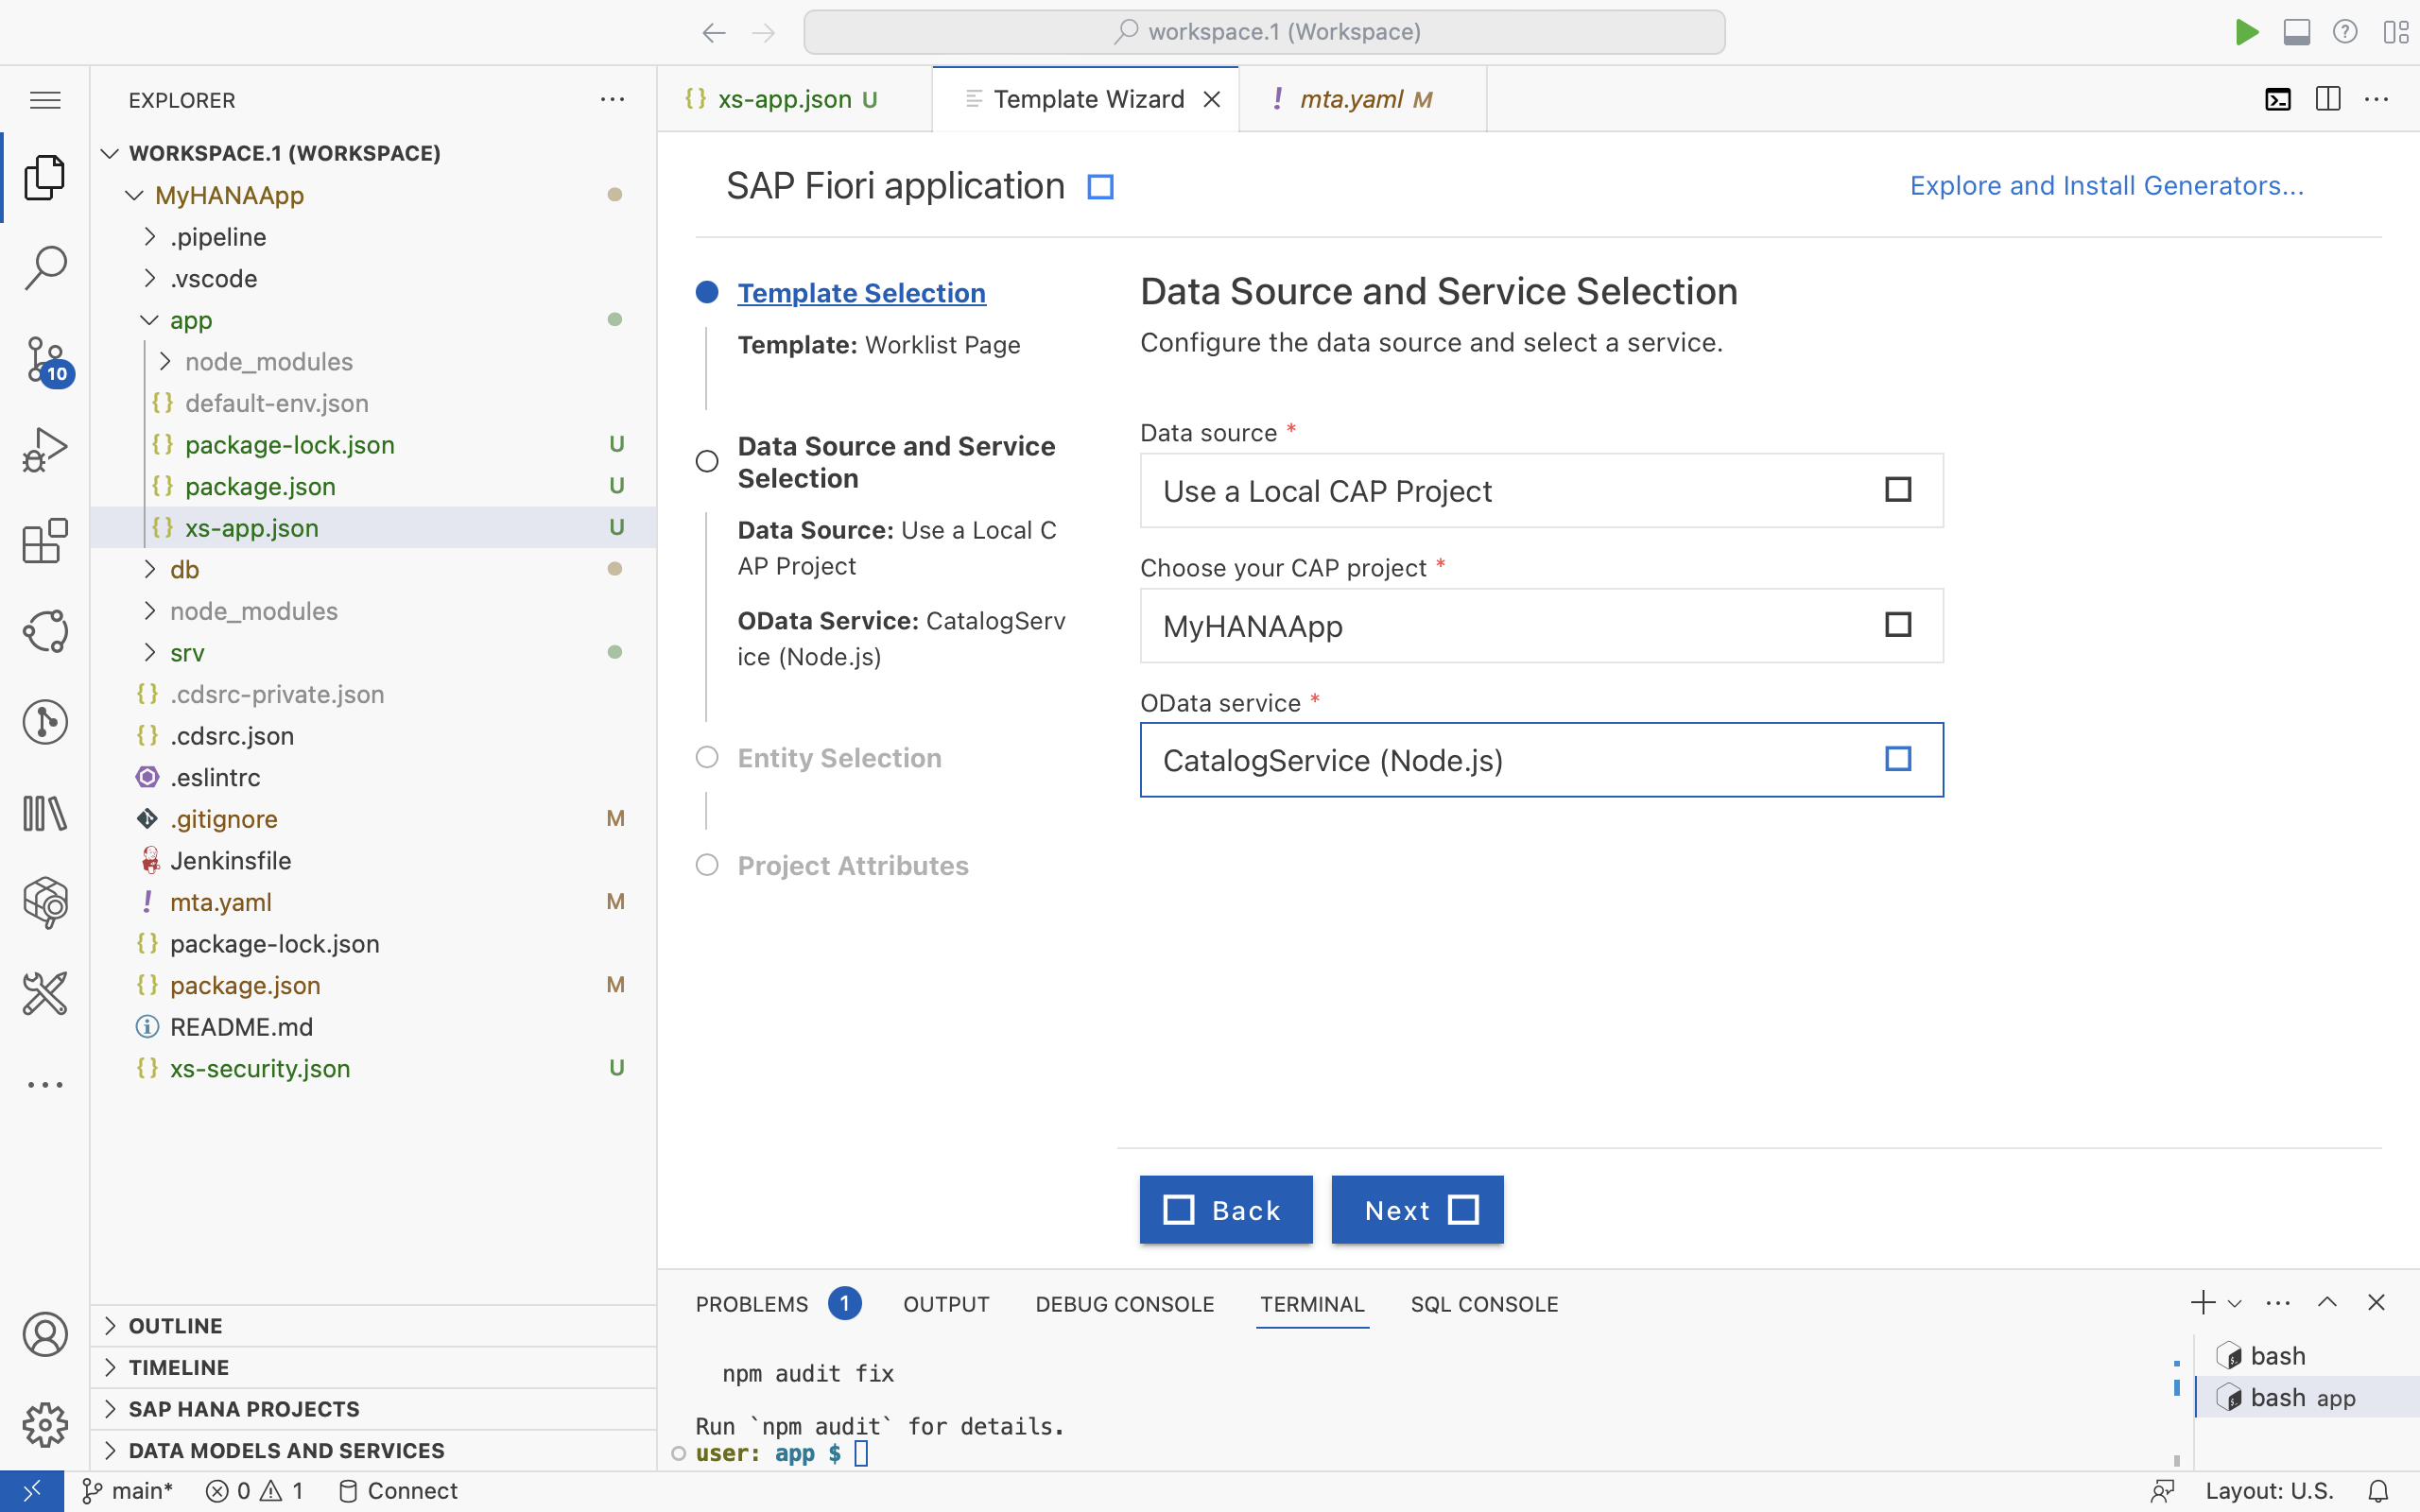

Slide 17
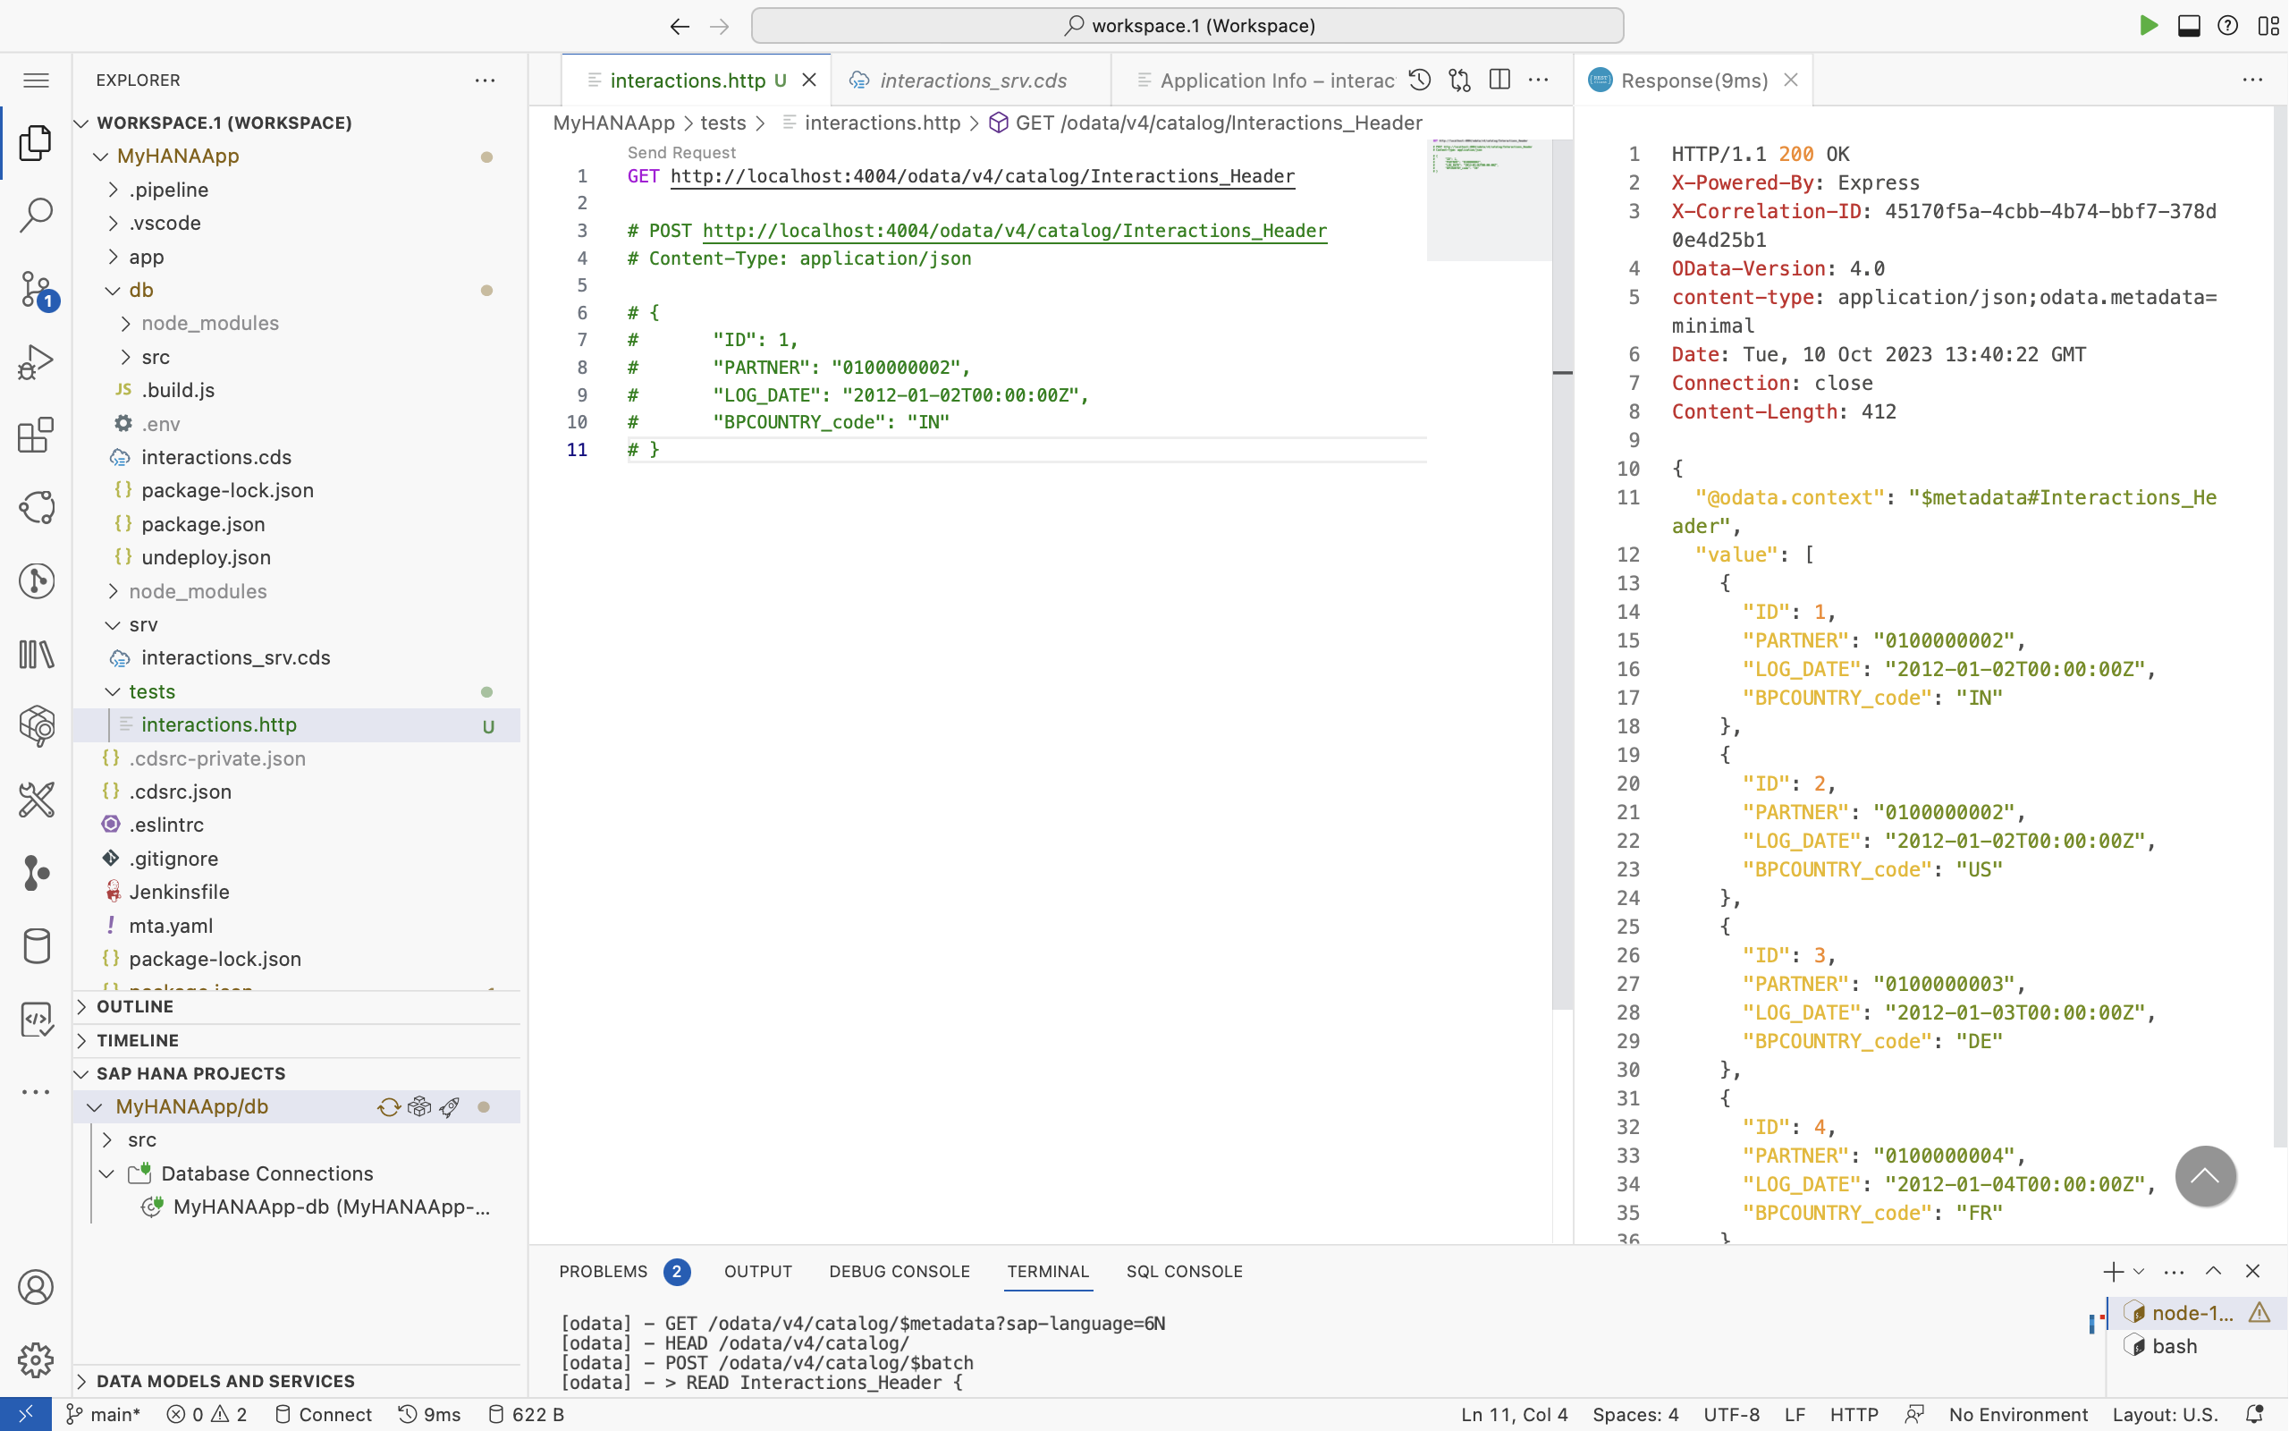

Slide 18
